Slide 1
Introduction to Python
– Using Python 3

Slide 2

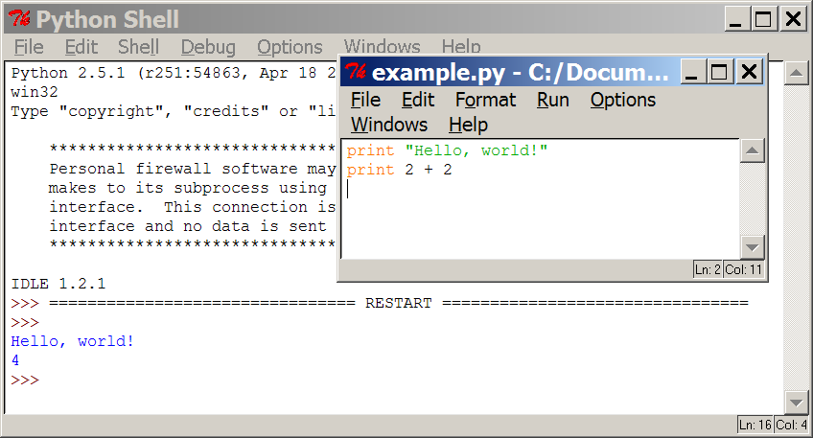
Programming basics
code or source code: The sequence of instructions in a program.
syntax: The set of legal structures and commands that can be used in a particular programming language.
output: The messages printed to the user by a program.
console: The text box onto which output is printed.
  Some source code editors pop up the console as an external window, and others contain their own console window.

Slide 3



Compiling and interpreting
Many languages require you to compile (translate) your program into a form that the machine understands.
Python is instead directly interpreted into machine instructions.
compile
execute
source code
Hello.java
byte code
Hello.class
output
interpret
source code
Hello.py
output

Slide 4
Expressions
expression: A data value or set of operations to compute a value.
  Examples: 1 + 4 * 3
  42
Arithmetic operators we will use:
  + - * / addition, subtraction/negation, multiplication, division
  % modulus, a.k.a. remainder
  ** exponentiation
precedence: Order in which operations are computed.
  * / % ** have a higher precedence than + -
  1 + 3 * 4 is 13
  Parentheses can be used to force a certain order of evaluation.
  (1 + 3) * 4 is 16

Slide 5
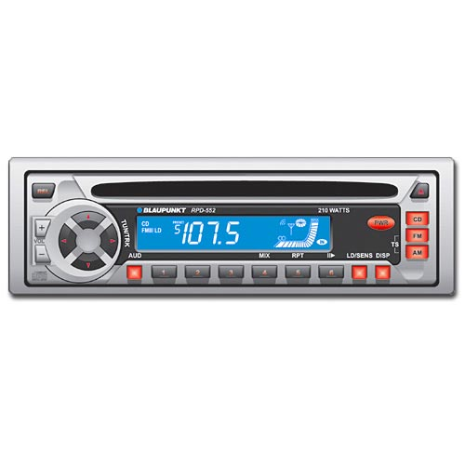
Variables
variable: A named piece of memory that can store a value.
  Usage:
    Compute an expression's result,
    store that result into a variable,
    and use that variable later in the program.
assignment statement: Stores a value into a variable.
  Syntax:
  name = value
  Examples: x = 5
  gpa = 3.14
  x 5 gpa 3.14
  A variable that has been given a value can be used in expressions.
  x + 4 is 9
Exercise: Evaluate the quadratic equation for a given a, b, and c.

Slide 6

What is Python?
  Python is a computer programming language
  Named after “Monty Python’s Flying Circus”
  Designed by Guido van Rossum starting in 1991 and continuing to this day (new versions)
Guido

Slide 7
Development Environments what IDE to use?
1. PyDev with Eclipse
2. Komodo
3. Emacs
4. Vim
5. TextMate
6. Gedit
7. Idle
8. PIDA (Linux)(VIM Based)
9. NotePad++ (Windows)
10.BlueFish (Linux)

Slide 8
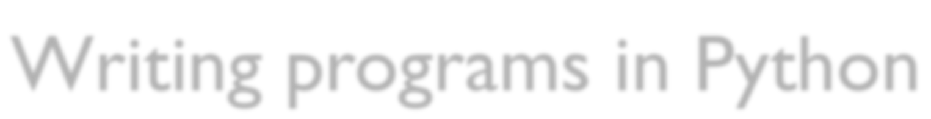
Writing programs in Python
Write a program in a text editor (this is called source code)
Save the source code to a file on the computer’s hard drive
  (normally with a name that ends in “.py”)
  e.g. “myprogram.py”
Execute the program by running the
python program on the file

Slide 9
Comments
  Comments are lines in a source code file that are "notes to the reader":
    Python just ignores them
  Comments start with a # and go to the end of the line:
#This is a comment.
  Comments are one way to document your code.

Slide 10
Running programs in Python
  To run the Python program called myprogram.py, you would go to the right directory and type one of these commands at the terminal prompt (and not including the >):
    > python myprogram.py
    > myprogram.py
  This would run the program, and when it's done, return you to the terminal prompt:
>

Slide 11
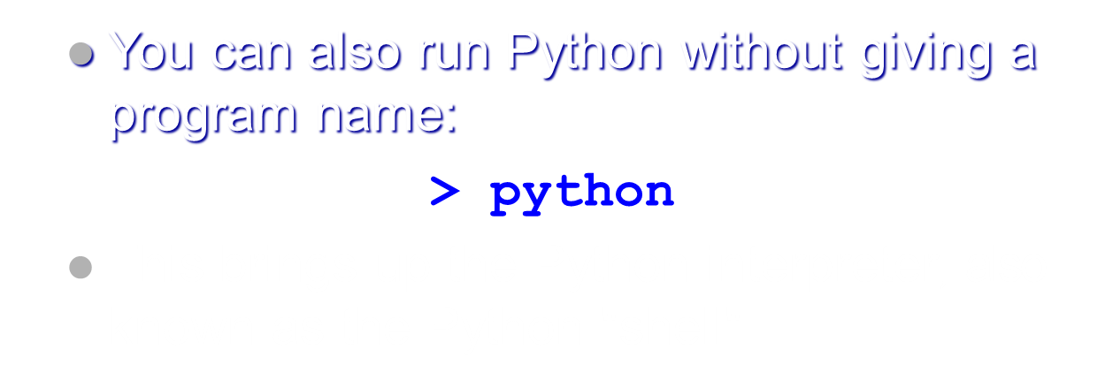
Running programs in Python

Slide 12
The Python shell
  The Python “shell” is just an interactive interpreter of Python code
  It prints a prompt (>>>) and waits for you to enter Python source code
  Then it evaluates your code, prints the result, and prints another prompt, etc.
  We will use this a lot in our examples

Slide 13
Python Interactive Shell
You can type things directly into a running Python session
>>> 2+3*4
14
>>> name = "Andrew"
>>> name
'Andrew'
>>> print ("Hello", name)
Hello Andrew
Try out also:
>>> 19 / 4
>>> 19 // 4
>>> 19 % 4

Slide 14
Python Modules
In practice, only the simplest programs are run in the shell
You can create a module by going to the File->New Window menu option
This brings up a text editor that lets you create a Python program and run it
Write your first “Hello World!” program thus:
print(“Hello, World!”)

Slide 15
Python Modules
Press F5
It will ask you to save the file before you run it
Save it to your home directory as HelloWorld.py
You must provide the .py extension
If you want to run it outside of the development environment simply type:
python HelloWorld.py
Note that Linux is case sensitive

Slide 16
Arithmetic expressions
  Arithmetic expressions contain numbers (operands) combined with symbols (operators) which compute values given the numbers
  Operators: + - * / etc.
  Numbers can be integers (no decimal point) or floating-point (with decimals)

Slide 17
Operator precedence
  What does 1 + 2 * 3 mean?
  It could mean
  1 + (2 * 3)
  (1 + 2) * 3
  Computer languages have precedence rules to determine meaning of ambiguous cases
  Here, * has higher precedence than +, so the first meaning is correct

Slide 18
Operator precedence
  What does 1 + 2 * 3 mean?
  It could mean
    1 + (2 * 3) Correct!
    (1 + 2) * 3
  Computer languages have precedence rules to determine meaning of ambiguous cases
  Here, * has higher precedence than +, so the first meaning is correct

Slide 19
Operator precedence
  In general, + and - have lower precedence than * and /
  and = is lower than either of them
  The ** (power) operator is even higher precedence than * and /
>>> 2 * 3 ** 4
162
  Use parentheses to force a different order of evaluation if you need it
>>> (2 * 3) ** 4
1296

Slide 20
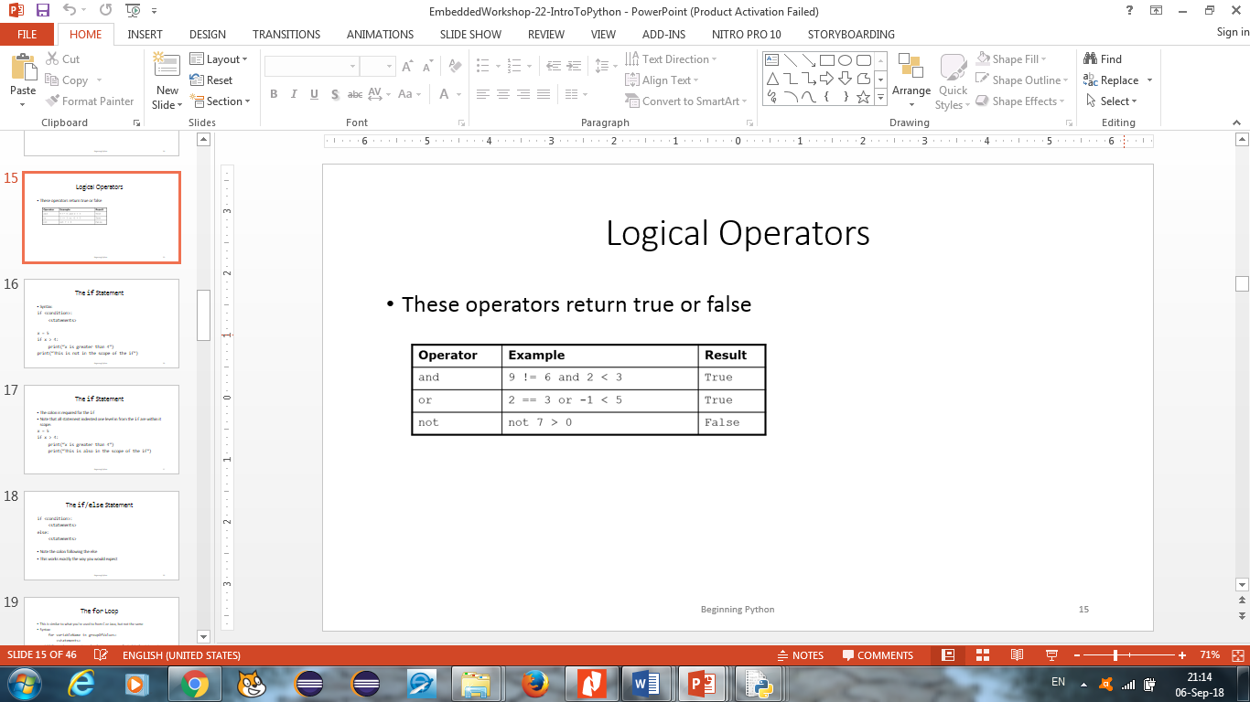
Logical Operators
These operators return true or false

Slide 21
Understanding Variables
Through variables, you can store and manipulate information
Python lets you create variables to organize and access this information.
Naming Variables (rule)
  1. A variable name can contain only numbers, letters, and underscores.
  2. A variable name can’t start with a number.
  3. Variable names are meaningful

Slide 22
Variables and assignment
Often, we want to give names to quantities
In Python, use the = (assignment) operator to do this:
>>> pi = 3.1415926535897931
From here on, pi stands for 3.1415...
>>> 4.0 * pi 12.566370614359172

Slide 23
Variables and assignment
Names assigned to variables can be reassigned:
>>> >>> | a a | = | 10
10 >>> | a | = | 20
>>> | a
20

Slide 24
Variables and assignment
Not any sequence of letters is a valid name:
a = 10
b1 = 20
this_is_a_name = 30
&*%$2foo? = 40
The first three are OK, the last not

Slide 25
Variables and assignment
Names of variables ("identifiers") can only consist of the letters a-z, A-Z, the digits 0-9, and the underscore character (_)
Can have as many letters as you like
Identifiers also cannot start with a digit
  avoids confusion with numbers
Identifiers can't contain spaces!
Case of letters is significant!
  Foo is a different identifier than foo

Slide 26
Variables and assignment
Can have expressions on the right-hand side of assignment statements:
>>> x = 5 * 3
>> x 15
The expression is terminated by the end of the line

Slide 27
Variables and assignment
Can use results of previous assignments in subsequent ones:
>>> | y | = | x | * | 5
>>> | y
75 >>> | z | = | x | + | y
>>> | z
90

Slide 28
Variables and assignment
Can use results of previous assignments in subsequent ones:
>>> z = z + 10
>>> z 100
Note: expressions like z = z + 10 are perfectly legal!

Slide 29
Variables and assignment
Evaluation rule for assignment statements:
  Evaluate the right-hand side
  Assign the resulting value to the variable on the left-hand side
This explains why z = z + 10
  previously, z was 90
  evaluate z + 10 → 100
  assign 100 to z (new value)
Variables can vary!

Slide 30
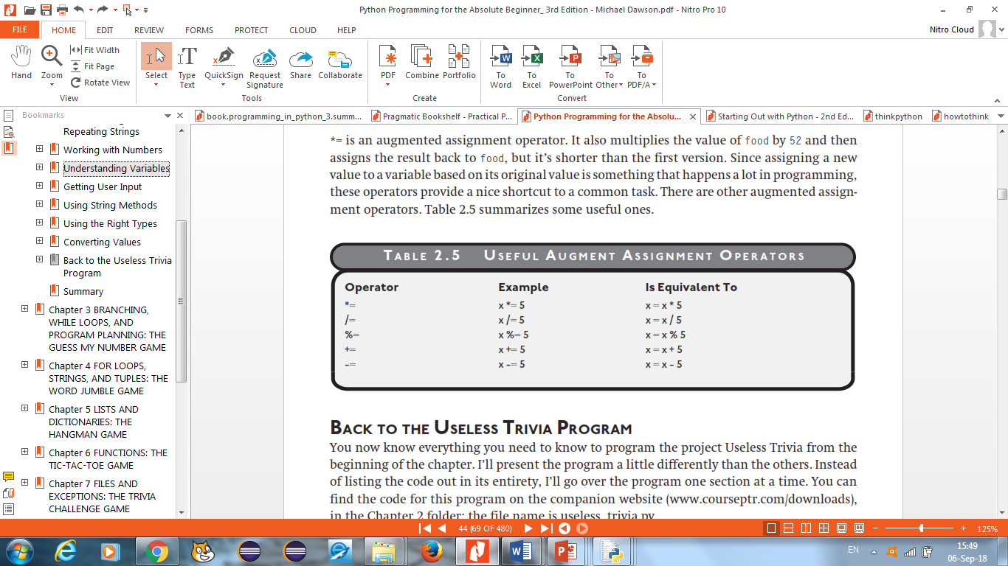
Using Augmented Assignment Operators
Find out what would the value of food be?
  food = 10
  food *=5
  Print(food)
Useful Augment Assignment Operators

Slide 31
Exercises
Greeter
  Demonstrate the use of a variable
Personal Greeter
  Demonstrates getting user input
Quotation Manipulation
  Demonstrates string methods
Returning the Sum
  Prompting the user to enter 2 numbers, add and return the sum

Slide 32
Exercises
1. Greeter
a. Declare a variable "name"
b. Assign a value to the variable
C. Print the variable as follows:
Hi name
Press the enter key to exit
2. Write a program that prompts a user:
a. To enter his/her name
b. Print " Hi name"
c. Wait for the user to Press the enter key to exit

Slide 33
Con’t
3. Write a program that:
i. Prompts the user to enter 2 numbers: a, b
ii. Adds the numbers
iii. Returns the result Sum: c

